Slide 1
Consumer Behavior
Slide <number>

Slide 2
Consumer Behavior
Slide <number>
There are 3 steps involved in studying consumer behavior.
Consumer preferences: describe how and why people prefer one good to another.
Budget constraints: people have limited incomes.
We will combine consumer preferences and budget constraints to determine consumer choices.
    What combination of goods will consumers buy to maximize their satisfaction?
Notes:
8

Slide 3
Consumer Preferences
Market Baskets
Slide <number>
A market basket is a collection of one or more commodities.
One market basket may be preferred over another market basket containing a different combination of goods.
Three Basic Assumptions
1) Preferences are complete.
2) Preferences are transitive.
3) Consumers always prefer more of a good to less.
Notes:
10

Slide 4
Consumer Preferences
Market Basket Units of Food Units of Clothing
Slide <number>
A 20 30
B 10 50
D 40 20
E 30 40
G 10 20
H 10 40
Notes:
12

Slide 5
Consumer Preferences
Slide <number>
Clothing
(units per week)
B
50
Combination B,A, & D
yield the same satisfaction
E is preferred to U₁
U₁ is preferred to H & G
H
E
40
A
30
D
20
G
U₁
10
Food
(units per week)
10
20
30
40
Notes:
17

Slide 6
Consumer Preferences
Slide <number>
Indifference curves represent all combinations of market baskets that provide the same level of satisfaction to a person.
Indifference Curves slope downward to the right.
    If they sloped upward it would violate the assumption that more of any commodity is preferred to less.
Notes:
18

Slide 7
Consumer Preferences
Slide <number>
Indifference Curves
  Any market basket lying above and to the right of an indifference curve is preferred to any market basket that lies on the indifference curve.
Indifference Curves
  Indifference curves cannot cross as this would violate the assumption that more is preferred to less
Notes:
19

Slide 8
Consumer Preferences
Slide <number>
Indifference Maps
An indifference map is a set of indifference curves that describes a person’s preferences for all combinations of two commodities.
  Each indifference curve in the map shows the market baskets among which the person is indifferent.
Notes:
20

Slide 9
Consumer Preferences
Slide <number>
Clothing
(units per week)
Market basket A
is preferred to B.
Market basket B is
preferred to D.
D
B
A
U₃
U₂
U₁
Food
(units per week)
Notes:
24

Slide 10
Consumer Preferences
Slide <number>
Clothing
(units
per week)
16
A
Observation: The amount
of clothing given up for
a unit of food decreases
from 6 to 1
14
12
-6
10
B
1
Question: Does this
relation hold for giving
up food to get clothing?
8
-4
D
6
1
-2
E
4
G
1
-1
2
1
Food
(units per week)
1
2
3
4
5
Notes:
32

Slide 11
Consumer Preferences
Slide <number>
Marginal Rate of Substitution
The marginal rate of substitution (MRS) quantifies the amount of one good a consumer will give up to obtain more of another good.
  It is measured by the slope of the indifference curve.
  Along an indifference curve there is a diminishing marginal rate of substitution.
Notes:
29

Slide 12

Consumer Preferences
Slide <number>
Clothing
(units
per week)
16
A
14
MRS = 6
12
-6
10
B
1
8
-4
D
MRS = 2
6
1
-2
E
4
G
1
-1
2
1
Food
(units per week)
1
2
3
4
5
Notes:
32
Indifference curves are convex because as more of one good is consumed, a consumer would prefer to give up fewer units of a second good to get additional units of the first one. Consumers prefer a balanced market basket.

Slide 13
Consumer Preferences
Marginal Rate of Substitution
Slide <number>
Perfect Substitutes and Perfect Complements
  Two goods are perfect substitutes when the marginal rate of substitution of one good for the other is constant.
  Two goods are perfect complements when the indifference curves for the goods are shaped as right angles.
Notes:
35

Slide 14
Consumer Preferences
Slide <number>
BADS
  Things for which less is preferred to more
Examples
  Air pollution
  Asbestos
What Do You Think?
  How can we account for Bads in the analysis of consumer preferences?

Slide 15
Consumer Preferences
Slide <number>
Application: Designing New Automobiles
Car executives must regularly decide when to introduce new models and how much money to invest in restyling.
An analysis of consumer preferences would help to determine when and if car companies should change the styling of their cars.
What Do You Think? How can we determine the consumers’ preferences?
Notes:
41
A recent study of automobile demand in the US shows that over the past two decades most consumers have preferred styling over performance.
Growth of Japanese Imports: 1970s and 1980s - 15% of domestic cars underwent a style change each year, compared to 23% for imports.

Slide 16
Consumer Preferences
Slide <number>
Utility
  Utility: Numerical score representing the satisfaction that a consumer gets from a given market basket.
If buying 3 copies of Microeconomics makes you happier than buying one shirt, then we say that the books give you more utility than the shirt.
Notes:
103

Slide 17
Consumer Preferences
Slide <number>
Utility Functions
  Assume: The utility function for food (F) and clothing (C) U(F,C) = F + 2C
  Market Baskets: F units C units U(F,C) = F + 2C
  A 8 3 8 + 2(3) = 14
  B 6 4 6 + 2(4) = 14
  C 4 4 4 + 2(4) = 12
  The consumer is indifferent to A & B.
  The consumer prefers A & B to C
Notes:
104

Slide 18
Consumer Preferences
Slide <number>
Clothing
(units
per week)
Utility Functions & Indifference Curves
Assume: U = FC
Market Basket U = FC
C 25 = 2.5(10)
A 25 = 5(5)
B 25 = 10(2.5)
15
C
10
A
U₃ = 100 (Preferred to U₂)
5
B
U₂ = 50 (Preferred to U₁)
U₁ = 25
Food
(units per week)
0
5
10
15
Slide <number>

Slide 19
Consumer Preferences
Slide <number>
Ordinal Versus Cardinal Utility
  Ordinal Utility Function: places market baskets from most preferred to least preferred, but does not indicate how much one market basket is preferred to another.
  Cardinal Utility Function: describes the extent to which one market basket is preferred to another.
Ordinal Versus Cardinal Rankings
  The actual unit of measurement for utility is not important. Therefore, an ordinal ranking is sufficient to explain how most individual decisions are made.
Notes:
27

Slide 20
Budget Constraints
Slide <number>
Preferences do not explain all of consumer behavior.
Budget constraints also limit an individual’s ability to consume in light of the prices they must pay for various goods and services.
The Budget Line: indicates all combinations of two commodities for which total money spent equals total income.
Notes:
46
42

Slide 21

Budget Constraints
Slide <number>
The Budget Line
  Let F equal the amount of food purchased, and C is the amount of clothing.
  If the price of food = P_{f} and price of clothing = P_{c}, then P_{f} F is the amount of money spent on food, and P_{c} C is the amount of money spent on clothing.
Notes:
48
42

Slide 22
Budget Constraints
Slide <number>
Market Basket Food (F) Clothing (C) Total Spending
P_{f} = ($1) P_{c} = ($2) P_{f}F + P_{c}C = I
A 0 40 $80
B 20 30 $80
D 40 20 $80
E 60 10 $80
G 80 0 $80
Notes:
50
12

Slide 23

Budget Constraints
Slide <number>
Clothing
(units
per week)
Pc = $2 P_{f} = $1 I = $80
(I/P_{C}) = 40
A
Budget Line F + 2C = $80
B
30
10
D
20
20
E
10
G
Food
(units per week)
0
20
40
60
80 = (I/P_{F})
Notes:
54
42

Slide 24
Budget Constraints
Slide <number>
The Budget Line
  As consumption moves along a budget line from the intercept, the consumer spends less on one item and more on the other.
  The slope of the line measures the relative cost of food and clothing = the negative of the ratio of the prices of the two goods.
  The slope indicates the rate at which the two goods can be substituted without changing the amount of money spent.
Notes:
55
42

Slide 25
Budget Constraints: Changes in Income and Prices
Slide <number>
Clothing
(units
per week)
An increase in
income shifts
the budget line
outward (holding
prices constant)
80
60
A decrease in
income shifts
the budget line
inward
40
20
L₃
(I =
$40)
L₁
L₂
(I = $80)
(I = $160)
Food
(units per week)
0
40
80
120
160
Notes:
61
42

Slide 26
Budget Constraints: Changes in Income and Prices
Slide <number>
Clothing
(units
per week)
An increase in P_{F}
to $2.00 changes
the slope of the
budget line and
rotates it inward
pivoting from the
other good’s intercept.
A decrease in the
price of food to
$.50 changes
the slope of the
budget line and
rotates it outward.
40
L₃
L₁
L₂
(P_{F} = 1)
(P_{F} = 1/2)
(P_{F} = 2)
Food
(units per week)
40
80
120
160
Notes:
65
42

Slide 27
Budget Constraints
Slide <number>
The Effects of Changes in Income and Prices
  Price Changes: If the two goods increase in price, but the ratio of the two prices is unchanged, the slope will not change. However, the budget line will shift inward to a point parallel to the original budget line.
  Price Changes: If the two goods decrease in price, but the ratio of the two prices is unchanged, the slope will not change. However, the budget line will shift outward to a point parallel to the original budget line.
Notes:
66
42

Slide 28
Consumer Choice
Slide <number>
Consumers choose a combination of goods that maximizes their satisfaction, given the limited budget available to them.
The maximizing market basket must satisfy two conditions:
1) It must be located on the budget line.
2) It must give the consumer the most preferred combination of goods and services.
Notes:
68

Slide 29
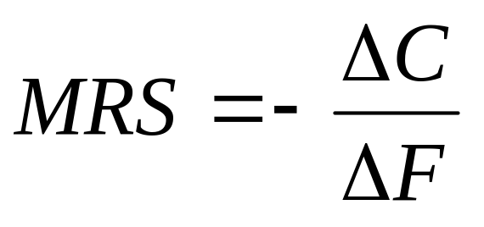

Consumer Choice
Slide <number>
Recall, the slope of an indifference curve is:
Further, the slope of the budget line is:
Notes:
70

Slide 30
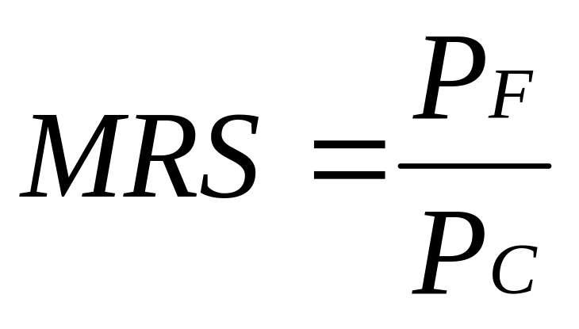
Consumer Choice
Slide <number>
Therefore, it can be said that satisfaction is maximized where:
Notes:
71
It can be said that satisfaction is maximized when marginal rate of substitution (of F and C) is equal to the ratio of the prices (of F and C).

Slide 31
Consumer Choice
Slide <number>
Clothing
(units per
week)
Pc = $2 P_{f} = $1 I = $80
Point B does not
maximize satisfaction
because the
MRS (-(-10/10) = 1
is greater than the
price ratio (1/2).
40
B
30
-10C
Budget Line
20
U₁
+10F
0
20
40
80
Food (units per week)
Notes:
76

Slide 32
Consumer Choice
Slide <number>
Clothing
(units per
week)
Pc = $2 P_{f} = $1 I = $80
40
D
Market basket D
cannot be attained
given the current
budget constraint.
30
20
U₃
Budget Line
0
20
40
80
Food (units per week)
Notes:
77

Slide 33
Consumer Choice
Slide <number>
Clothing
(units per
week)
Pc = $2 P_{f} = $1 I = $80
At market basket A
the budget line and the
indifference curve are
tangent and no higher
level of satisfaction
can be attained.
40
30
A
20
At A:
MRS =P_{f}/P_{c} = .5
U₂
Budget Line
0
20
40
80
Food (units per week)
Notes:
78

Slide 34
Consumer Choice
Slide <number>
Application: Designing New Automobiles
Consider two groups of consumers, each wishing to spend $10,000 on the styling and performance of cars.
Each group has different preferences.
By finding the point of tangency between a group’s indifference curve and the budget constraint auto companies can design a production and marketing plan.
Notes:
79

Slide 35
Consumer Choice
Slide <number>
A Corner Solution
A corner solution exists if a consumer buys in extremes, and buys all of one category of good and none of another.
  This exists where the indifference curves are tangent to the horizontal and/or vertical axis.
  MRS is not equal to P_{A}/P_{B} at the chosen bundle.
Notes:
83

Slide 36
A Corner Solution
Slide <number>
Frozen
Yogurt
(cups
monthly)
A
A corner solution
exists at point B.
U₁
U₂
U₃
B
Ice Cream (cup/month)
Notes:
84
At point B, the MRS of ice cream for frozen yogurt is greater than the slope of the budget line. This suggests that if the consumer could give up more frozen yogurt for ice cream he would do so. However, there is no more frozen yogurt to give up! If the MRS is, in fact, significantly greater than the price ratio, then a small decrease in the price of frozen yogurt will not alter the consumer’s market basket.

Slide 37

Consumer Choice
Slide <number>
A Corner Solution
  When a corner solution arises, the consumer’s MRS does not necessarily equal the price ratio.
In this instance it can be said that:
Notes:
86

Slide 38
Consumer Choice
Slide <number>
A College Trust Fund
Suppose Jane Doe’s parents set up a trust fund for her college education.
Originally, the money must be used for education.
If part of the money could be used for the purchase of other goods, her preferred consumption bundle changes.
Notes:
88

Slide 39
Consumer Choice
Slide <number>
A College Trust Fund
Other
Consumption
($)
A: Consumption before the trust fund
The trust fund shifts the budget line
B: Requirement that the trust fund
must be spent on education
C
P
U₃
C: If the trust could be spent on
other goods
B
A
U₂
U₁
Q
Education ($)
Notes:
92

Slide 40
Revealed Preferences
Slide <number>
If we know the choices a consumer has made, we can determine what her preferences are if we have information about a sufficient number of choices that are made when prices and income vary.
Notes:
93

Slide 41
Revealed Preferences – 2 Budget Lines
Slide <number>
Clothing
(units per
month)
l₁
I₁: Chose A over B
A is revealed preferred to B
l₂: Choose B over D
B is revealed preferred to D
l₂
A
B
D
Food (units per month)
Notes:
97

Slide 42
Revealed Preferences for Recreation
Slide <number>
Other
Recreational
Activities
($)
Scenario
Roberta’s recreation budget = $100/wk
Price of exercise = $4/hr/week
Exercises 10 hrs/wk at A given U₁ & I₁
100
C
80
The rate changes to $1/hr + $30/wk
New budget line I₂ & combination B
Reveal preference of B to A
60
A
B
40
U₁
U₂
Would the Club’s
profits increase?
20
l₁
l₂
Amount of Exercise
(hours)
0
25
50
75
Notes:
102

Slide 43
Marginal Utility and Consumer Choice
Slide <number>
Marginal Utility
Marginal utility = the additional satisfaction obtained from consuming one additional unit of a good.
Example
  The marginal utility derived from increasing from 0 to 1 units of food might be 9
  Increasing from 1 to 2 might be 7
  Increasing from 2 to 3 might be 5
Observation: Marginal utility is diminishing: as more and more of a good is consumed, consuming additional amounts will yield smaller and smaller additions to utility.
Notes:
107

Slide 44
Marginal Utility and Consumer Choice
Slide <number>
Marginal Utility and the Indifference Curve
  If consumption moves along an indifference curve, the additional utility derived from an increase in the consumption one good, food (F), must balance the loss of utility from the decrease in the consumption in the other good, clothing (C).
Notes:
110

Slide 45
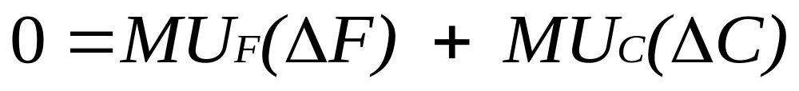

Marginal Utility and Consumer Choice
Slide <number>
Formally:
Rearranging:
Notes:
111

Slide 46


Marginal Utility andConsumer Choice
Slide <number>
Because:
Notes:
113

Slide 47


Marginal Utility and Consumer Choice
Slide <number>
When consumers maximize satisfaction the:
Since the MRS is also equal to the ratio of the marginal utilities of consuming F and C, it follows that:
Notes:
115

Slide 48

Marginal Utility and Consumer Choice
Slide <number>
Which gives the equation for utility maximization:
Notes:
116
Total utility is maximized when the budget is allocated so that the marginal utility per dollar of expenditure is the same for each good.
This is referred to as the equal marginal principle.

